Slide 1
Lecture 9
8086 Microprocessor
Pins and Signals

Slide 2
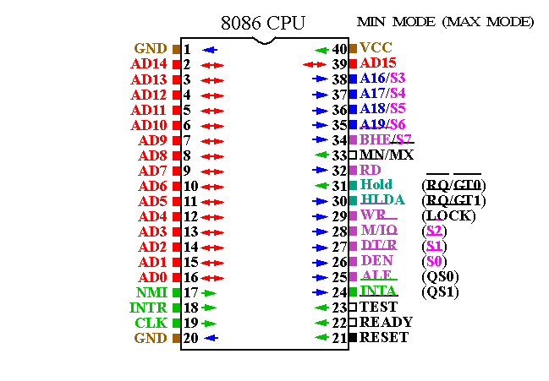

Slide 3
Modes of 8086
8086 pins and signals can be configured in two modes by MN/MX input pin
  Minimum mode (MN/MX = 1): support single processor systems using few devices that use system bus.
  Maximum mode (MN/MX = 0): support multiprocessor systems and Intel 8288 bus controller is added to the 8086 to provide bus controls and compatibility with multi bus architecture

Slide 4
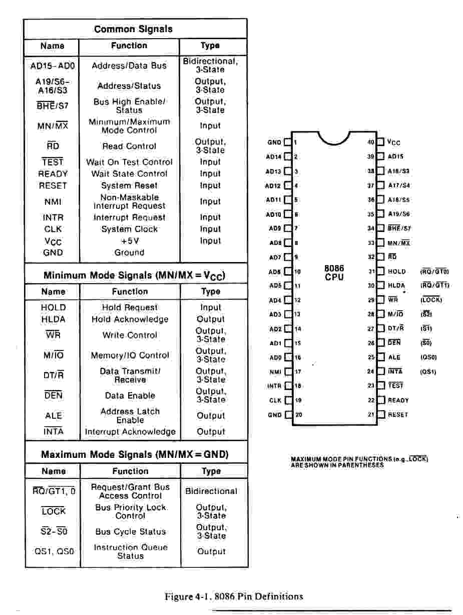
8086 Microprocessor

Slide 5
Minimum mode (MN/MX = 1) Signals
DT/R (Data transmit / Receive): Output pin. 8086 outputs high to transmit data and outputs low to receive data through the transceiver (8286/8287)
DEN (Data Enable): Output pin. 8086 outputs low on this pin to enable transceiver.
ALE (Address latch Enable): Output pin. Used to demultiplex AD₁₅ to AD₀ into A₁₅ - A₀ and D₁₅ -D₀ when high to low occurs on this pin.
M/IO (Memory / Input output): Output pin. 8086 outputs high on this pin during memory access and outputs low on this pin during input/output operation.
WR: Output pin. 8086 outputs low on this pin to indicate the memory or I/O write operation.
INTA (Interrupt acknowledge): 8086 outputs low to acknowledge the interrupt request on the INTR pin.

Slide 6
Minimum mode Signals
HOLD : input pin. A HIGH on this pin indicates that another device (Ex. DMA controller) is requesting to take over the system bus.
HLDA (Hold acknowledge): Output pin. 8086 outputs high on this pin to acknowledge the HOLD request.
CLK (Clock): Input pin. Provides the basic timing for the 8086 and bus controller. Clock signal come from a chip (8284).

Slide 7
Minimum mode Signals
HOLD : input pin. A HIGH on this pin indicates that another device (Ex. DMA controller) is requesting to take over the system bus.
HLDA (Hold acknowledge): Output pin. 8086 outputs high on this pin to acknowledge the HOLD request.
CLK (Clock): Input pin. Provides the basic timing for the 8086 and bus controller. Clock signal come from a chip (8284).

Slide 8
Maximum mode (MN/MX = 0) Signals
S2, S1, S0 : output pin. These signals from 8086 are input to 8288 bus controller, 8288 decodes the inputs to generate bus timing and control signals for maximum mode operation of 8086. S2, S1, S0 are decoded as follows:
S2 S1 S0
0 0 0 Interrupt Acknowledge
0 0 1 Read I/O port
0 1 0 Write I/O port
0 1 1 Halt
1 0 0 Code Access
1 0 1 Read Memory
1 1 0 Write Memory
1 1 1 Inactive

Slide 9
Maximum mode (MN/MX = 0) Signals
RQ/GT0 : Bidirectional pin. A pulse from another device indicates a local bus request to the 8086. After the executing bus cycle a pulse from the 8086 to the requesting device indicates release of system bus for the device. After the device finishes its work, it send a low on this pin to release the system bus back to the processor.
RQ/GT1 : Bidirectional pin. Function is same as RQ/GT0. with only difference is that RQ/GT0 has higher priority than RQ/GT1.
LOCK : Output pin. 8086 outputs LOW on this pin to prevent other devices from gaining control of the system bus.
QS1, QS0(queue status): output pins. Provide queue status to the external world in the following way:
QS1 QS0
0 0 No operation
0 1 First byte of operation code from queue
1 0 The queue is empty
1 1 Subsequent byte from the queue

